Slide 1

Training Plan & Materials
Team 5: Vanilla Systems
Presenter: Bezawit Tessema
IT-493-DL1
Date: 3/19/2023
George Mason University

Slide 2

Training
Training implies teaching a special skill to achieve better processes and business growth (Colin, 2021).
Learn new skills and improve current ones
Reduce cost
Increase individual and business performance

Slide 3

Training Plan
Provides comprehensive details about a training
Increase productivity
Provides Better organization
Address specific challenges of the business

Slide 4
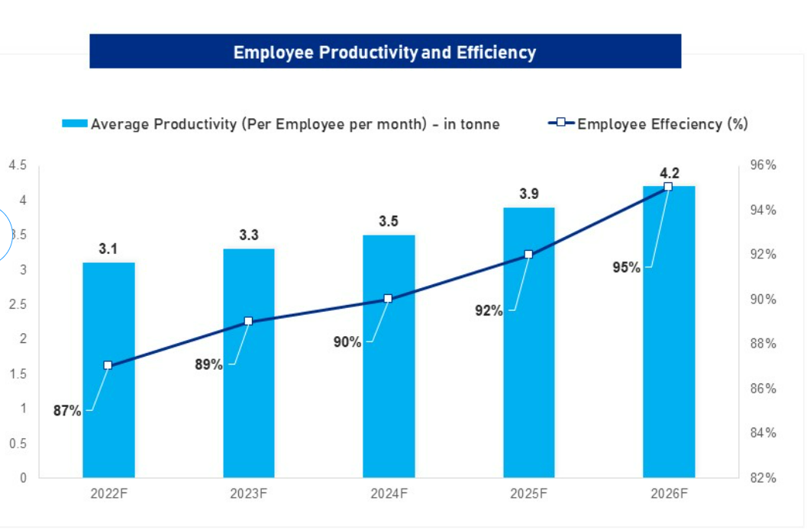
Training Plan

Slide 5

Areas Requiring Client Training
Maintaining, modifying, and managing content on the website

Slide 6
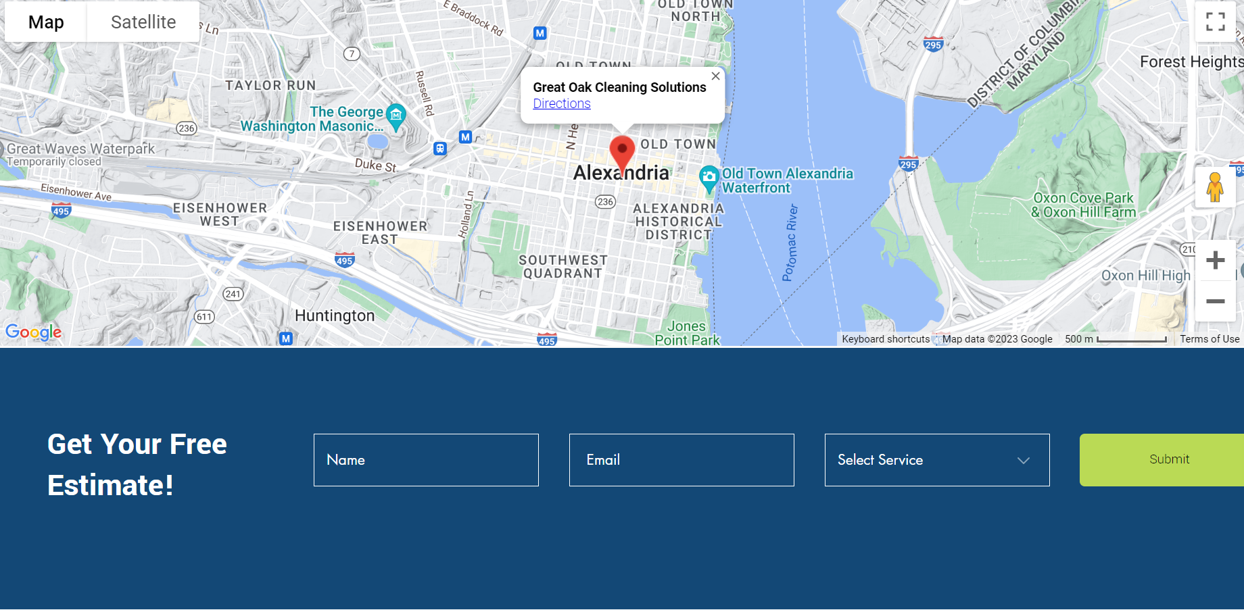
Areas Requiring Client Training
Providing customer service by viewing requests made by users and providing appropriate service.

Slide 7

Areas Requiring Client Training
Make any changes to the prices for the cleaning quotes made, to cleaning products they sell, and payment options accepted.

Slide 8
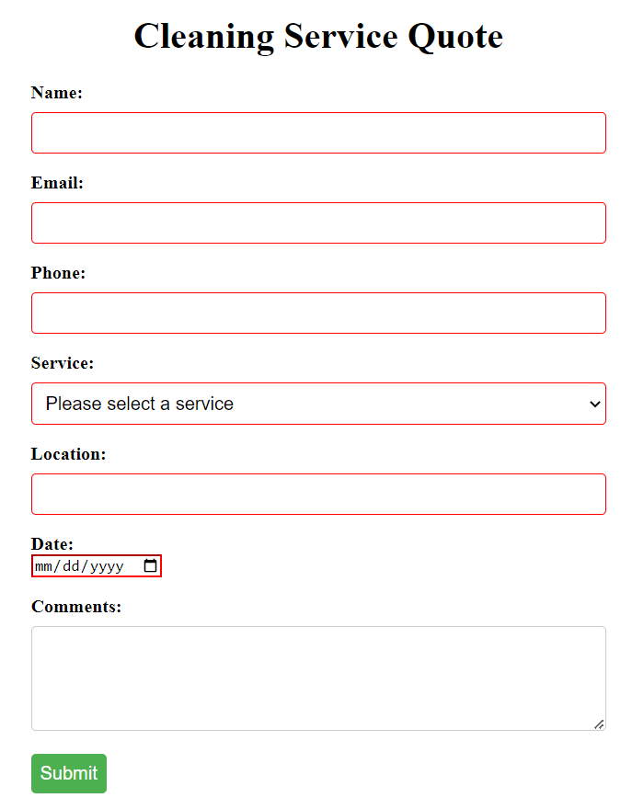
Areas Requiring Client Training
Manage security of the website to protect end users data
Updating and configuring encryption methods
Configuration of security features for text entry

Slide 9
Format of the Training
Hybrid Training Model
Mixture of remote, in-person and recorded training guide
Ongoing throughout the development life cycle
Remote training
Conducted using Discord and Zoom, standard mode of communication between group and client
Allows for “show-and-tell” from both the client and group side
In-person
Guided demonstration that will happen simultaneously with remote
Boots on ground approach allows for better support with client side issues than remote alone
Recorded
Final demonstration of solution will be recorded as an in depth walkthrough of the entire product
Will be edited into bookmarked portions for easy reference

Slide 10
Training Schedule
Deliverable | Start time and date | End time and date
Introduction to the website/ view requests made by users requesting service by using the website we provide | 04/23/2023 6:00 PM | 04/23/2023 7:00 PM
Maintain, modify and manage contents on the website websites | 04/23/2023 7:00 PM | 04/23/2023 8:00 PM
How to troubleshoot server issues | 04/24/2023 6:00 PM | 04/24/2023 7:00 PM
How to debug code and train fundamentals of programming languages | 04/24/2023 7:00 PM | 04/24/2023 8:00 PM
How to use CSS frameworks and develop responsive layouts | 05/01/2023 6:00 PM | 05/01/2023 7:00 PM
How to effectively manage the security of the website to avoid potential data breaches and access by unauthorized users | 05/01/2023 7:00 PM | 05/01/2023 8:00 PM

Slide 11
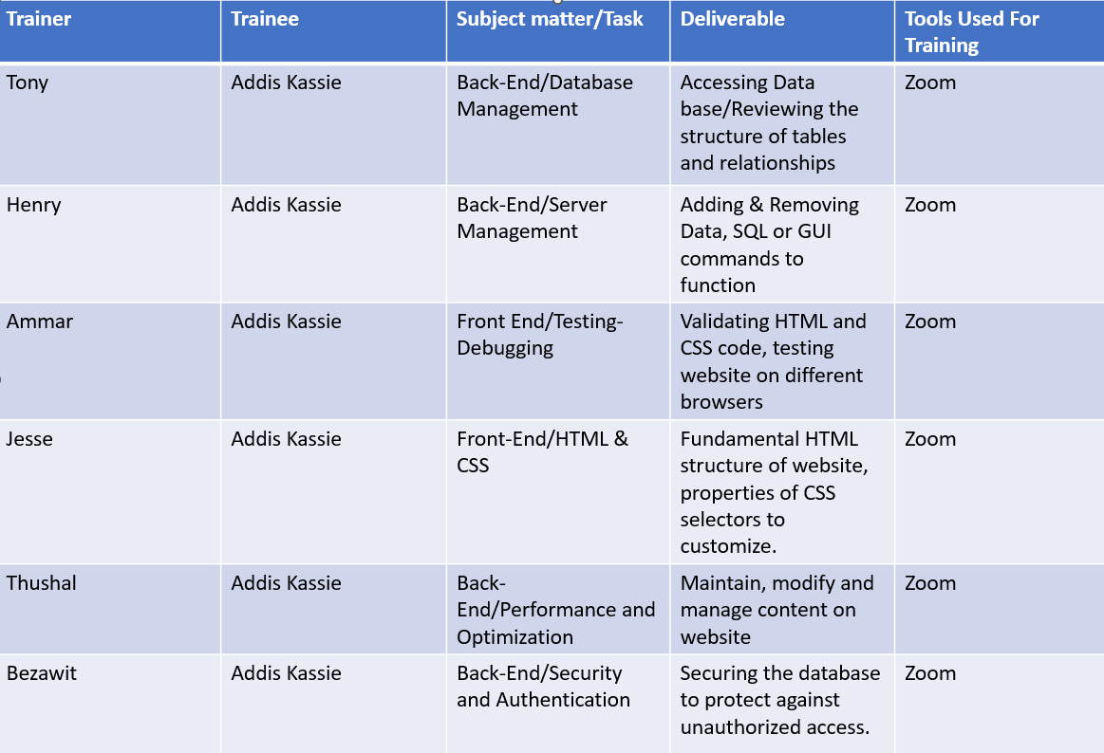
Training Resources: Who will Produce and Provide?

Slide 12

Formal Training Materials
User Guide & Walkthrough Video
Saves Time
Reduce Workload for Support Team
Provides Professionalism to Company's Image

Slide 13
Sources
Colin, B. (2021). The Importance Of Training Your Employees: 25 Reasons. Retrieved from https://www.thinkific.com/blog/why-training-is-important/
Josh, B. (2022). How to Create an Employee Training Plan. Retrieved from https://helpjuice.com/blog/employee-training-plan-templates
Project Management Institute. (2017). A guide to the project management body of knowledge (PMBOK guide). Newtown Square, Pa: Project Management Institute.
Seismic. (2023). The importance of training. Retrieved from https://seismic.com/enablement-explainers/the-importance-of-training/
Simplilearn (2022). Top 10 Ways to Increase Productivity at Work. Retrieved from https://www.simplilearn.com/tutorials/productivity-tutorial/proven-ways-of-how-to-increase-productivity-at-work

